Slide 1
Handwritten Digit Recognition using Map-Reduce
CSE 6331: Cloud Computing
Submitted by : Parth Joshi (1001556783)
Vrushali Kadam (1001514762)

Slide 2
Introduction
(a) Concept of HandWritten Digits Recognition:
Handwriting recognition is the ability of a computer to retrieve and interpret handwriting input from sources such as paper documents, photographs, touch-screens and other devices.
(b) Dataset:
Digits from 0 to 9 represented by 28 x 28
784 feature columns, each having some value where the first column represents the true class label.
The dataset has a training set of 60,000 examples, and a test set of 10,000 examples.
(c) Approach for Predictive Analysis:
Implement K-Means algorithm for training a model to classify the digits based on the clustering technique. The model is trained based on the training data and tested for accuracy using the test dataset. To minimize the response time for the predictions, implement Map-Reduce program that evaluates one step of k-means clustering.

Slide 3
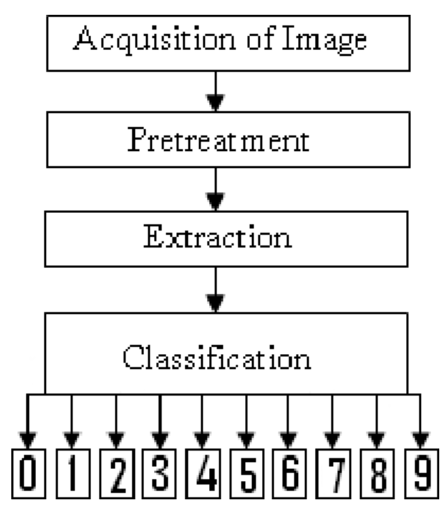
Handwritten Digits Recognition

Slide 4
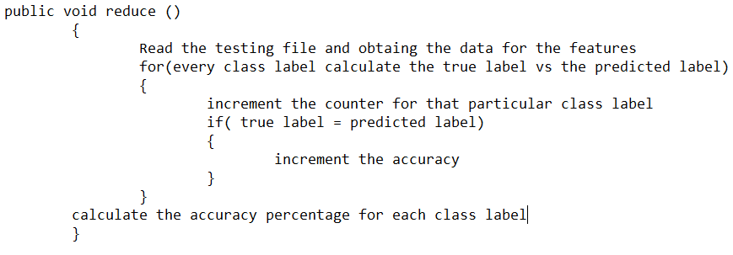
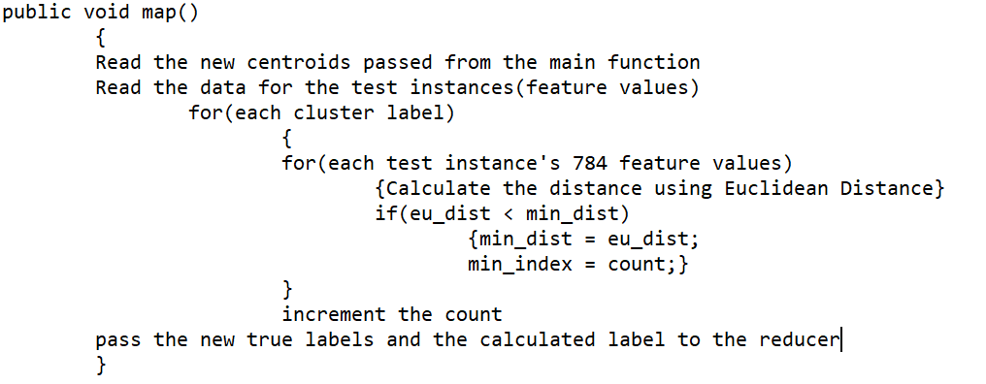
Methodology
(a) Training the model with centroids generated from training data for each of the 10 clusters using the true cluster label.
(b) The Mapper function:
(c) The Reducer function:
(d) Conclusion:
Accuracy for each class label
Over all accuracy of 85%-90%

Slide 5
Conclusion
Solved the classic Kmeans clustering technique to get the labels for the test data with improved response time.
The success of classification of the handwritten digit dataset can be extended further to other advanced areas with implementation of Convoluted Neural Networks and also by adding Backpropagation for better results.

Slide 6
Thank You!

